Slide 1
Introduction to the .NET
Prof. Yousef B. Mahdy
Faculty of Computers and Information
Assiut University

Slide 2
Learning Objectives
Introduction to the .NET development platform
Notes:
This module is designed to provide you with a basic background in Internet/Web technologies and current technologies for creating Web-based applications. It also provides an overview of the .NET development platform, the details of which comprise the remainder of the course.

Slide 3
Agenda
Programming Languages and Paradigms
.NET Overview

Slide 4
Programming Languages
Machine code
Assembly language
High-level languages
  Fortran, LISP, Cobol
  C, Pascal, Basic, Smalltalk
  C++, Eiffel
  Java, C#
Scripting languages
  Shell scripts, Perl, TCL, Python, JavaScript, VBScript

Slide 5
Programming Paradigms
Unstructured programming
Structured programming
Object-oriented programming
Component-based programming
Event-based programming

Slide 6
Programming Paradigms
Unstructured Programming
See “Go To Statement Considered Harmful” at http://www.acm.org/classics/oct95/
Notes:
In reality, the “go to” statement is not inherently “evil”, but should be used in a structured manner. C# supports “go to”s, but only in a limited way.

Slide 7
Programming Paradigms
Structured Programming
Sequence
Conditional
  if then else
  switch
Looping
  for i from 1 to n
  do while
  do until
Functions
Exceptions
Notes:
Structured programming addresses the problems involved in writing a single procedure. It doesn’t help too much when large-scale systems are involved.

Slide 8
Programming Paradigms
Object-Oriented Programming
Objects have data and behavior
  Data: members, fields, variables, slots, properties
  Behavior: methods, functions, procedures
Using objects is easy
  First instantiate the type of object desired
  Then call its methods and get/set its properties
Designing new types of objects can be hard
  Design goals often conflict: simplicity, functionality, reuse, performance
Notes:
Object-oriented programming actually builds upon structured programming. Structured programming techniques are used within individual methods.

Slide 9
Programming Paradigms
Object-Oriented Programming
Key object-oriented concepts
  Identity
  Encapsulation
    Data + behavior
    Information hiding (abstraction)
  Classes vs. instances
  Polymorphism
  Interfaces
  Delegation, aggregation
  Inheritance
  Patterns

Slide 10
Programming Paradigms
Component-Based Programming
Components
  Independent modules of reuse and deployment
  Coarser-grained than objects
  (objects are language-level constructs)
  Includes multiple classes
  Often language-independent
In the general case, the component writer and the component user don’t know each other, don’t work for the same company, and don’t use the same language
Notes:
Components build upon object-oriented concepts.

Slide 11
Programming Paradigms
Component-Based Programming
Component Object Model (COM)
  Initial Microsoft standard for components
  Specifies a protocol for instantiating and using components in-process, across processes or
  across machine boundaries
  Basis for ActiveX, OLE, and many other technologies
  Can be created in Visual Basic, C++, .NET, …
Java Beans
  Java standard for components
  Not language-independent

Slide 12
Programming Paradigms
Event-Based Programming
When something of interest occurs, an event is raised and application-specific code is executed
Events provide a way for you to hook in your own code into the operation of another system
Event = callback
User interfaces are all about events
  onClick, onMouseOver, onMouseMove…
Events can also be based upon time or interactions with the network, operating system, other applications, etc.

Slide 13
Agenda
Programming Languages and Paradigms
.NET Overview

Slide 14
.NET Overview
Introduction to .NET
Web Services
The .NET Framework
Common Language Runtime
Windows Forms
Web Forms
ADO.NET
Languages

Slide 15
Introduction to .NET
What is .NET?
A vision of how information technology
will evolve
A platform that supports the vision
A business model of software as a service
Notes:
.NET is a broad initiative that can be viewed from several perspectives.

Slide 16
Introduction to .NET
What is .NET?
A vision
  Web sites will be joined by Web services
  New smart devices will join the PC
  User interfaces will become more adaptable
  and customizable
  Enabled by Web standards
Notes:
.NET will enable the next generation of applications.

Slide 17
Introduction to .NET
What is .NET?
A platform
  The .NET Framework
  Visual Studio.NET
  .NET Enterprise Servers
    Database, Messaging, Integration,
    Commerce, Proxy, Security, Mobility,
    Orchestration, Content Management
  .NET Building Block Services
    Passport
    .NET My Services (“Hailstorm”)
  Goal: make it incredibly easy to build powerful Web applications and Web services
Notes:
Microsoft is providing a suite of products and services to facilitate building this next generation. This course focuses on the .NET Framework and Visual Studio.NET.

Slide 18
Introduction to .NET
What is .NET?
A business model
  Software as a service
  Subscription-based services
  Application hosting, e.g. bCentral

Slide 19
Introduction to .NET
The .NET Platform
Clients
Applications
Web Form
Web Service
.NET Framework
Protocols: HTTP,
HTML, XML,
SOAP, UDDI
Tools:
Visual Studio.NET,
Notepad
Windows
Your Internal
Web Service
.NET Foundation
Web Services
Third-Party
Web Services
.NET Enterprise
Servers
Notes:
Each blue box represents a separate computer (or cluster of computers).

Slide 20




A Unified Model
Consistent API availability regardless of
language and programming model
.NET Framework
RAD,
Composition,
Delegation
Subclassing,
Power,
Expressiveness
Stateless,
Code embedded
in HTML pages
VB Forms
MFC/ATL
ASP
Windows API

Slide 21
Web Services
A programmable application component accessible via standard Web protocols
The center of the .NET architecture
Exposes functionality over the Web
Built on existing and emerging standards
  HTTP, XML, SOAP, UDDI, WSDL, …
Notes:
The definition of a Web service is “a programmable application component accessible via standard Web protocols.” In other words, it is a component that can be called remotely from a client application, over the Internet.
Web Services will allow people, companies, customers, suppliers, doctors, patients, etc. to interact using different computers, different operating systems, and different applications.
For example, you could use the same Web Service to store your personal and work calendar information. You could access this information from different applications and view and change it in different ways.

Slide 22



Web Services
Evolution of the Web
HTML, XML
HTML
HTML
HTML, XML
Generation 1
Static HTML
Generation 2
Web Applications
Generation 3
Web Services
Notes:
The first generation of Web applications was largely about delivering non-interactive content, i.e. publishing non-interactive HTML pages. For example, many applications simply operated in client/server mode and rendered HTML pages to send across the internet to browsers.
The second generation of Web applications was about creating applications usable over the Web. E-commerce is an example; you can go to http://www.barnesandnoble.com/ select books, order them and pay for them. This second generation also includes a more scalable back-end (e.g. WinDNA architecture) and a richer UI (e.g. DHTML and ActiveX).
However, useful though they may be, the second generation largely resulted in application islands on the Web. Yes, there are hyperlinks between sites, but for the most part, the actual applications at different sites do not interact.
The third generation of Web application is about using Web protocols and XML throughout to allow better integration between services on the Web. Protocols such as XML and SOAP allow you to create Web Services, enabling people and companies to easily create integrated applications.

Slide 23
The .NET Framework
What Is the .NET Framework?
A set of technologies for developing and using components to create:
  Web Forms
  Web Services
  Windows Applications
Supports the software lifecycle
  Development
  Debugging
  Deployment
  Maintenance
Notes:
The .NET Framework provides a set of technologies that makes creating, deploying, using and maintaining applications (including Web applications and Web Services) much easier and more robust.

Slide 24
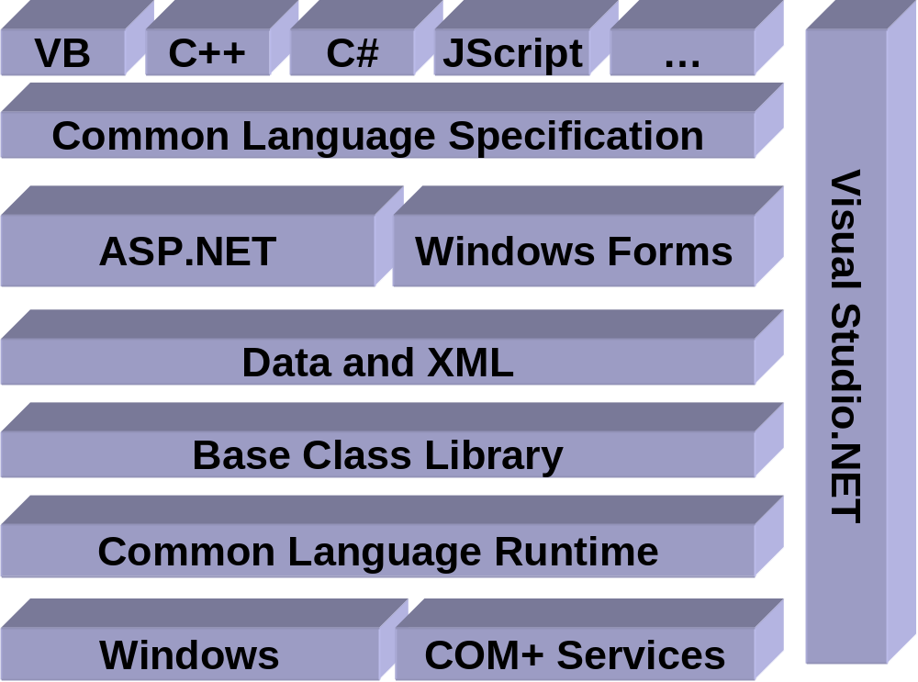
The .NET Framework
The .NET Framework and Visual Studio.NET

Slide 25
The .NET Framework
.NET Framework Classes
System.Web
System.Windows.Forms
Services
UI
Form
Button
Description
HtmlControls
MessageBox
ListControl
Discovery
WebControls
Protocols
System.Drawing
Caching
Security
Drawing2D
Printing
Configuration
SessionState
Imaging
Text
System.Data
System.Xml
OLEDB
SQL
XSLT
Serialization
Design
SQLTypes
XPath
System
Collections
IO
Security
Runtime
Configuration
Net
ServiceProcess
InteropServices
Diagnostics
Reflection
Text
Remoting
Globalization
Resources
Threading
Serialization
Notes:
This is but a brief illustration of the breadth of classes provided by the .NET Framework. We will explore many of these classes during this course.
All of these classes are available to ALL languages.

Slide 26
Common Language Runtime
Goals (CLR)
Development services
  Deep cross-language interoperability
  Increased productivity
Deployment services
  Simple, reliable deployment
  Fewer versioning problems – NO MORE ‘DLL HELL’
Run-time services
  Performance
  Scalability
  Availability
Reliability
Security
Safety
Notes:
The Common Language Runtime provides the underlying infrastructure for the .NET Framework. It provides very little application-visible functionality itself (security being a notable exception), but provides services to make development, deployment and execution much better in almost every way.

Slide 27
Common Language Runtime
Compilation
Source Code
Assembly
Compiler
C++, C#, VB or any .NET language
csc.exe or vbc.exe
DLL or EXE
Notes:
As a developer you can write code in the language of your choice. Your code is compiled into an Assembly, which is represented as a DLL or EXE.

Slide 28
Compilation & Execution
Compilation
MSIL
Source Code
Language Compiler
Code
Metadata
JIT Compiler
Native
Code
Before installation or the first time each method is called
Execution
Notes:
The diagram above illustrates the process used to compile and execute managed code, that is, code that uses the CLR. Source code written in C#, VB.NET, or some other language that targets the CLR is first transformed into MSIL by the appropriate language compiler. Before execution, this MSIL is JIT compiled into native code for whatever processor the code will run on. The default is to JIT compile each method when it is first called, but it’s also possible to “pre-JIT” the MSIL. With this option, all methods are compiled before the application is loaded, so the overhead of JIT compilation on each initial method call is avoided.
One point worth noting is that all languages targeting the CLR should exhibit roughly the same performance. While some compilers may produce better MSIL code than others, large variations in execution speed are unlikely.

Slide 29
Common Language Runtime
Assemblies
Assembly
  Logical unit of deployment
  Contains Manifest, Metadata, MSIL and resources
Manifest
  Metadata about the components in an assembly (version, types, dependencies, etc.)
Type Metadata
  Completely describes all types defined in
  an assembly: properties, methods, arguments, return values, attributes, base classes, …
Notes:
IL is always compiled, never interpreted.

Slide 30
Common Language Runtime
Assemblies
Microsoft Intermediate Language (MSIL, IL)
  All languages compile to IL (managed code)
  IL is always compiled to native code before
  being executed
Resources
  E.g. .bmp, .jpg

Slide 31
Common Language Runtime
Execution Model
Source code
VB
C#
C++
Compiler
Compiler
Compiler
MSIL
Assembly
Assembly
Assembly
Ngen
Common Language Runtime JIT Compiler
Native
code
CLR
Managed
Code
Managed
Code
Managed
Code
Unmanaged
Code
CLR Services
Operating System Services
Notes:
When an assembly starts running, the JIT (Just In Time) compiler in the Common Language Runtime converts the IL in the assembly to efficient machine code. It is this code that is actually executed.

Slide 32
Common Language Runtime
Services
Code management
Conversion of MSIL to native code
Loading and execution of managed code
Creation and management of metadata
Verification of type safety
Insertion and execution of security checks
Memory management and isolation
Handling exceptions across languages
Interoperation between .NET Framework objects and COM objects and Win32 DLLs
Automation of object layout for late binding
Developer services (profiling, debugging, etc.)
Notes:
The CLR provides many sophisticated services.

Slide 33
Common Language Runtime
Multiple Language Support
Common Type System (CTS)
  A superset of the data types used by most modern programming languages
Common Language Specification (CLS)
  A subset of CTS that allows code written in different languages to interoperate
What languages?
  Microsoft: C++, Visual Basic, C#, JScript
  Third-Party: Cobol, Eiffel, Smalltalk, Scheme, Oberon, Haskell, Java, Python, Perl, …
Notes:
The CTS supports many types of data. It allows each language to implement its own unique features.
The CLS allows different languages to interoperate in a deep manner. For example, you can create a class in C# that derives from a class written in Eiffel, and is called from a Perl program.

Slide 34
Common Language Runtime
Applications
An application consists of one or more assemblies
How does one assembly bind to another?
  Based upon metadata and policy
    Local (preferred)
    Assembly Global Cache
Multiple versions of an assembly may exist on
the same machine
  Easier software deployment, updates and removal
  Multiple versions of an assembly can even be used by the same application
Notes:
When we execute an application, how are the required assemblies located? Quite simply; the class loader (part of the CLR) will search the current directory for any assemblies. Assemblies should be kept within the same directory as the application that requires them. This allows different versions of the software to be installed on the machine without interfering with each other. However, if required, it is possible to share an assembly using the global assembly cache.

Slide 35
Common Language Runtime
Security
Evidence-based security (authentication)
Based on user identity and code identity
Configurable policies
Imperative and declarative interfaces
Notes:
Before code in an assembly is run, the CLR looks at the identity of both the user and the code. You can specify policies that determine which code can be executed, and the priviledges that code will have when it runs.

Slide 36
Windows Forms
Windows Forms is a framework for building rich Windows client applications, and can be written in any language that supports .NET.
Windows Forms provide the developer with many features, such as:
The simplicity that Visual Basic 6 programmers are used to.
Easy deployment. Windows Forms (as .NET applications) automatically takes advantage of the versioning and deployment features of the .NET Framework.
Windows Forms offers an architecture for controls and control containers based on concrete implementation of the control and container classes. This significantly reduces control-container interoperability issues.
Security. Windows Forms takes full advantage of the security features of .NET. This means that Windows Forms can be used to implement everything from an untrusted control running in the browser to a fully trusted application installed on a user's hard drive.
Web Services Support. Windows Forms offer full support for quickly and easily connecting to Web Services.
Rich Graphics.

Slide 37
Windows Forms
Controls. Windows Forms offer a rich set of controls that encompass all of the controls offered by Windows and new features such as new "flat look" styles for Buttons, Radio Buttons and Checkboxes.
Data Awareness. Windows Forms offer full support for the ADO.NET data model.
ActiveX Controls. Windows Forms offer full support for ActiveX controls. You can easily host ActiveX controls in a Windows Forms application. You can also host a Windows Form control as an ActiveX control.
Licensing. Windows Forms take advantage of the .NET Framework enhanced licensing model.
Printing. Windows Forms offer a printing framework that enables applications to provide comprehensive reports.
Accessibility. Windows Form controls implement the interfaces defined by Microsoft Active Accessibility (MSAA), making it straightforward to build applications that support accessibility aids such as screen readers.

Slide 38
Windows Forms
Framework for building rich clients
Built upon .NET Framework, languages
Rapid Application Development (RAD)
Visual inheritance
Anchoring and docking
Rich set of controls
Extensible controls
Data-aware
Easily hooked into
Web Services
ActiveX support
Licensing support
Printing support
Advanced graphics
Notes:
Windows Forms is a framework for building rich Windows client applications, and can be written in any language that supports .NET.
Windows Forms provide the developer with many features, such as:
The simplicity that Visual Basic 6 programmers are used to.
Easy deployment. Windows Forms (as .NET applications) automatically takes advantage of the versioning and deployment features of the .NET Framework.
Windows Forms offers an architecture for controls and control containers based on concrete implementation of the control and container classes. This significantly reduces control-container interoperability issues.
Security. Windows Forms takes full advantage of the security features of .NET. This means that Windows Forms can be used to implement everything from an untrusted control running in the browser to a fully trusted application installed on a user's hard drive.
Web Services Support. Windows Forms offer full support for quickly and easily connecting to Web Services.
Rich Graphics.
Controls. Windows Forms offer a rich set of controls that encompass all of the controls offered by Windows and new features such as new "flat look" styles for Buttons, Radio Buttons and Checkboxes.
Data Awareness. Windows Forms offer full support for the ADO.NET data model.
ActiveX Controls. Windows Forms offer full support for ActiveX controls. You can easily host ActiveX controls in a Windows Forms application. You can also host a Windows Form control as an ActiveX control.
Licensing. Windows Forms take advantage of the .NET Framework enhanced licensing model.
Printing. Windows Forms offer a printing framework that enables applications to provide comprehensive reports.
Accessibility. Windows Form controls implement the interfaces defined by Microsoft Active Accessibility (MSAA), making it straightforward to build applications that support accessibility aids such as screen readers.

Slide 39
ASP.NET
The first incarnation of ASP proved very successful. As part of the .NET Framework, Microsoft supports ASP.NET. ASP.NET is a logical evolution of ASP that addresses many of the issues previously associated with ASP.
ASP.NET is now compiled and not interpreted. This of course can go some way towards improving efficiency and also means that code can now support strongly typed variables other than VARIANTS. This makes ASP.NET much more flexible and easier to code.
A great deal of work has also been done to make sure that ASP.NET development has become cleaner and more productive.

Slide 40
Web Forms
Built with ASP.NET
  Logical evolution of ASP
  Similar development model: edit the page and go
Requires less code
New programming model
  Event-driven/server-side controls
  Rich controls (e.g. data grid, validation)
  Data binding
  Controls generate browser-specific code
  Simplified handling of page state

Slide 41
Web Forms
Allows separation of UI and business logic
Uses .NET languages
  Not just scripting
Easy to use components
XCOPY/FTP deployment
Simple configuration (XML-based)

Slide 42
Web Forms
Caching (pages, fragments, custom)
Scalable session state management
Tracing support
ASP.NET is extensible
  No ISAPI / ASP dichotomy
Automatic process rollover
Forms-based authentication

Slide 43
ADO.NET
Similar to ADO, but better factored
Language-neutral data access
Supports two styles of data access
  Disconnected
  Forward-only, read-only access
Supports data binding
DataSet: a collection of tables
Can view and process data relationally (tables) or hierarchically (XML)
Notes:
ADO.NET evolves from ADO, and is designed to deal with the issues of state, scalability and XML compatibility.
Although existing ADO developers will find all of the old ADO classes inside the ADO.NET data model, they will also find that a few new classes have been introduced, including the DataSets, DataReaders and DataSetCommands classes.

Slide 44
Languages
C#
C# is a new language designed to take advantage of most of the features of the .NET Framework.
C# was designed from the ground up to support component concepts like events, methods and properties.
In C#, everything is an object, which allows the creation of very clean designs.
C# was designed to make it easy to create robust and maintainable software.
C# should allow you to presearve your existing investment by integrating easily with your existing cod
Notes:
C# is a new language designed to take advantage of most of the features of the .NET Framework.
C# was designed from the ground up to support component concepts like events, methods and properties.
In C#, everything is an object, which allows the creation of very clean designs.
C# was designed to make it easy to create robust and maintainable software.
C# should allow you to presearve your existing investment by integrating easily with your existing code.

Slide 45
Languages
Visual Basic.NET
VB.NET is a modernized version of Visual Basic. It is integrated with the .NET Framework, but still provides language constructs, features and syntax that is familiar to Visual Basic developers.
Inheritance
  Threading
  Exception handling
Support for late binding
Uses .NET Framework classes

Slide 46
Compilation & Execution
Compilation
MSIL
Source Code
Language Compiler
Code
Metadata
JIT Compiler
Native
Code
Before installation or the first time each method is called
Execution
Notes:
The diagram above illustrates the process used to compile and execute managed code, that is, code that uses the CLR. Source code written in C#, VB.NET, or some other language that targets the CLR is first transformed into MSIL by the appropriate language compiler. Before execution, this MSIL is JIT compiled into native code for whatever processor the code will run on. The default is to JIT compile each method when it is first called, but it’s also possible to “pre-JIT” the MSIL. With this option, all methods are compiled before the application is loaded, so the overhead of JIT compilation on each initial method call is avoided.
One point worth noting is that all languages targeting the CLR should exhibit roughly the same performance. While some compilers may produce better MSIL code than others, large variations in execution speed are unlikely.

Slide 47
A Unified Model
Consistent API availability regardless of
language and programming model
.NET Framework
RAD,
Composition,
Delegation
Subclassing,
Power,
Expressiveness
Stateless,
Code embedded
in HTML pages
VB Forms
MFC/ATL
ASP
Windows API

